Slide 1
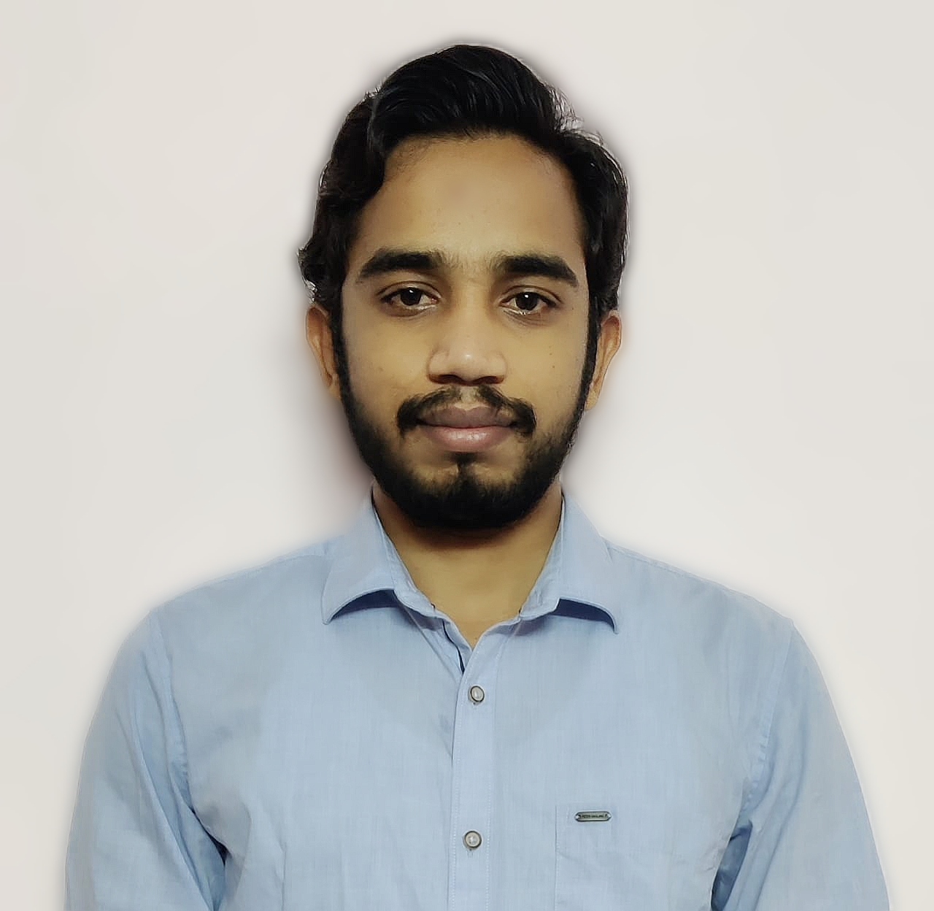
Shiva Rama Krishna V
SAP PI/PO Consultant
Mobile : +917013025345
Email : vummenthalashivaramakrishna@gmail.com
Education :
Master of Business Administration
Technical Skills :
SAP PI/PO
MS Office Tools
CURRICULUM VITAE
Project Profile :
Project – 2
Client : GE Industries
(Manufaturing Industries)
Position : SAP PO Consultant
Type : Development and Support
Project
Project – 1
Client : ABB
Position : SAP PO Consultant
Type : Support Project
Summary :
Professional with complete 5+ years of experience in process and IT consulting for the service industry 2 years of IT administration and 3+ in SA PI/PO Implementation and support project, Proven ability to design, development and implementation new solution and in the customization of existing solution to specifications.
Roles and Responsibilities :
Experience in creating SLD (Technical System and Business System), Enterprise Service Repository (Operational Mapping, Message Mappings, Interface Mapping), Integration Directory (Routing Channels, Receiver/Interface Determination.
Developed interfaces using File, SFTP, IDOC, JMS, JDBC, SOAP, REST, Adapters.
Setup message archiving and deletion.
Experience in analysing business specification documents, developing test plans, defining test cases.
Prepare cutover steps for Go-Live activities, hyper care and production support.
End to End testing and troubleshooting reported issues quickly develop and deploy bug fixes.
Moving transport requests from DEV, QA &Production system and resolved issues
Experience in Import/Export object for other systems manually.
Daily health checks for the system and taking proactive actions.
User administration, creating/ Modifying roles based on the requirements.
Involved live disaster recovery drill.
Involved for monthly upgrades/implementation activities and performed post sanity checks
Experience in preparing monthly audit document.
Previous Experience – Detailing :
Development and Support projects

